Slide 1
MKTG 571:
Customer Metrics
Managing Metrics to Maximize Profitability

Slide 2
Today’s Agenda
To discuss how different metrics can be managed by firms to maximize profitability
To provide specific examples from business of how to measure and manage customer metrics for cross-buying and product returns

Slide 3
Cross-buying
Cross-buying is defined as how many product categories a customer purchases.
Traditional Selling vs. New Selling:
  The old question: “How many customers can we sell a product to?”
  The new question: “How many products can we sell to a customer?”
Source: Shah and Kumar (2008)

Slide 4
Cross-buying
Examples of cross-selling at different firms:
  Amazon tries to cross-sell through its recommendation system
  Rental car companies (e.g. Hertz and Enterprise) try to sell supplemental insurance to car renters
  Fast food restaurants (e.g. McDonalds) bundle a fries and drink with your sandwich order

Slide 5
Cross-buying
Key Questions:
  Does cross-selling always lead to higher profits?
  (In other words, does it always make sense to cross-sell to every customer?)
  How do we go about figuring this out?

Slide 6
Cross-buying
Problem Setup:
  Used a customer database from a major multinational bank with branch locations in more than 25 countries
  The bank offers 11 products (e.g. checking, savings, credit cards, loans [home, car, personal], etc.)
  The sample extracted included 30k customers who started their relationship with the bank in January 2004
  The sample included all transaction behavior from January 2004 to December 2007

Slide 7
Cross-buying
Problem Setup:
  At the end of 4 years, the variable cross-buy was computed and customers were sorted into 3 buckets:
  Low Crossbuy: 1 to 2 categories
  Medium Crossbuy: 3 to 4 categories
  High Crossbuy: 5 or more categories

Slide 8
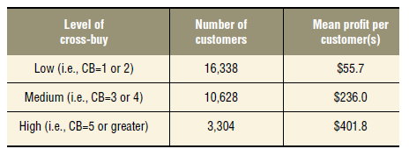
Cross-buying
Preliminary results:
Does this mean that customers who cross-buy more are more profitable?

Slide 9
Cross-buying
What if we:
  Compute the correlation coefficient between cross-buying and profitability?
  Rank order the customers based on profitability and sort them into deciles?

Slide 10
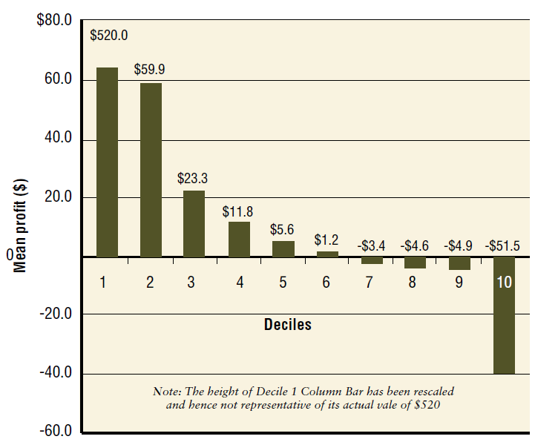
Cross-buying
Low
Cross-buy
Customers

Slide 11
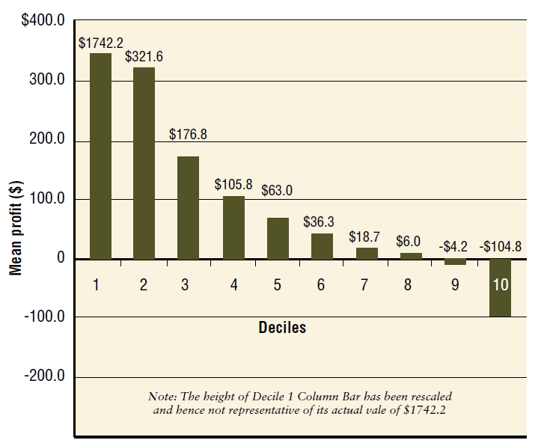
Cross-buying
Medium
Cross-buy
Customers

Slide 12
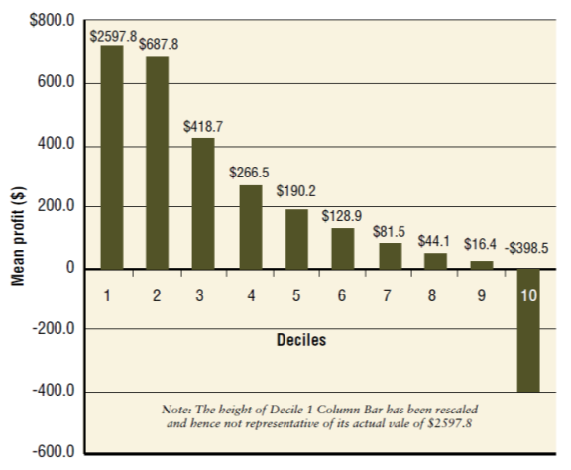
Cross-buying
High
Cross-buy
Customers

Slide 13
Cross-buying
The results raise several questions and bear substantive implications on how firms should execute cross-selling activities.
  Why do you think cross-selling activities are not always working?
  What can we do about it?

Slide 14
Cross-buying
What about cross-selling products with the highest margins?
In the financial services industry, which products have the highest margins?

Slide 15
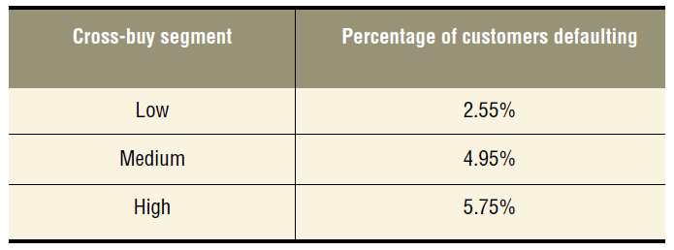
Cross-buying
Turns out that home loans are not always the best…

Slide 16
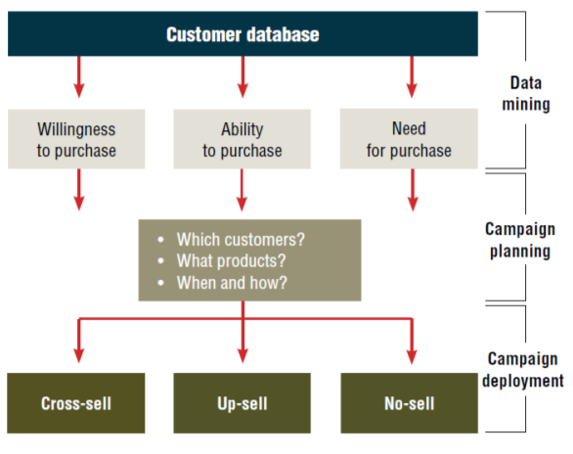
Cross-buying
So, is there
a general
framework
we can apply?

Slide 17
Cross-buying
Summary:
  Not all customers who buy more products are necessarily profitable
  Not all customers who are profitable buy more products
  The key here is in understanding when cross-selling can be profitable and when it is likely not profitable

Slide 18
Product Returns
Background:
  How much do product returns cost firms?
  What are some good/bad product return experiences you have had?
Source: Petersen and Kumar (2010)

Slide 19



Product Returns
What are Firms Doing?
  Streamlining Reverse Logistics
  Giving Disincentives to Return Products
To:
John Q. Customer
Demon Customers
You’re Fired!!!

Slide 20
Product Returns
Study 1: Three key questions
  What purchase or customer characteristics tend to lead to more product returns?
  How can we strategically manage customer product return behavior to maximize profit?
  What is the trade-off between the cost of product returns and the benefit of increased future purchase behavior?

Slide 21
Product Returns: Study 1
Problem Setup:
  Two cohorts of customers from a catalog retailer (first purchase made in 1998 and 1999)
  The firm was extremely lenient with each customer’s product return behavior – return at any time in the future for a full refund

Slide 22
Product Returns: Study 1
Data:
 | Cohort 1 (1998) | Cohort 2 (1999)
Customers | 1,572 | 1,586
Catalogs Sent | 135,949 | 118,867
Purchases (Number) | 25,178 | 23,368
Purchases (Value) | $1.08M | $1.0M
Product Returns (Number) | 4,113 | 3,394
Product Returns (Value) | $196k | $169k

Slide 23
Product Returns: Study 1
Preliminary findings:
  The number of catalogs a customer received decreased as the rate of product returns increased
  The customer’s amount of future purchase increased (to a threshold) as the rate of product returns increased
  Current average product return rate across all customers was around 16%

Slide 24
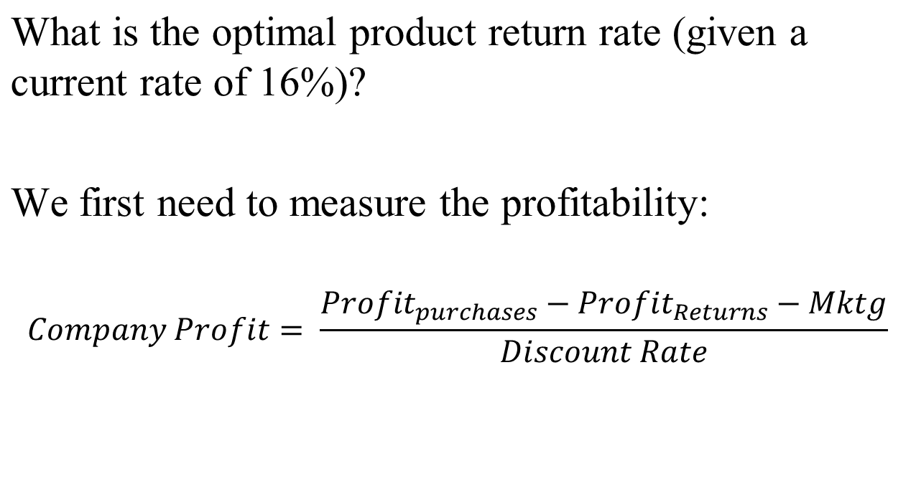
Product Returns: Study 1

Slide 25
Product Returns: Study 1
Then we can run an optimization:
Change in Product Return Amount from current level (16%) | Firm Profits (Cohort 1 – n = 1,572) | Firm Profits (Customer Base – n = 1M)
-15% | $63,937 | $40.7M
-10% | $81,551 | $51.9M
-5% | $92,151 | $58.6M
-3% | $93,567 | $59.5M
0% | $91,829 | $58.4M
5% | $76,222 | $48.5M
10% | $40,504 | $25.8M
15% | ($20,608) | ($13.1M)

Slide 26
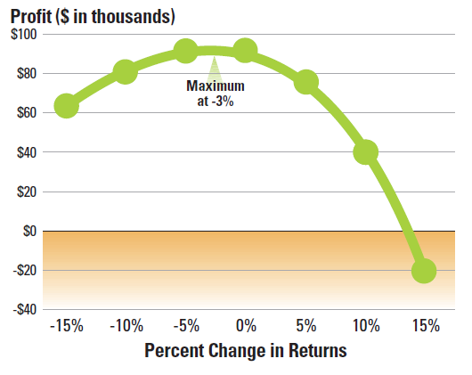
Product Returns: Study 1
Graphically:
(Cohort 1)

Slide 27
Product Returns: Study 1
So what do we do with customers:
  Who have never returned a product (25% of the database)? Who have returns between 0-13%? Who have returns over 13%?
How do we change our catalog mailing policy?

Slide 28
Product Returns: Study 1
It might be important to understand the drivers of product returns:
  What do you think are some drivers of fewer product returns?
  What about drivers of more product returns?

Slide 29
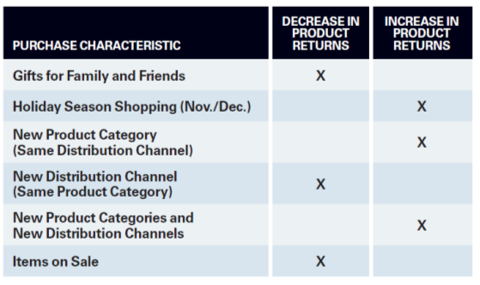
Product Returns: Study 1
Do these findings make sense?
What can we do?

Slide 30
Product Returns: Study 2
Were the previous findings only because the company had a lenient product return policy?
What is the difference between a lenient and a strict product return policy?
How do we test which one is better?

Slide 31
Product Returns: Study 2
Problem Setup:
  Company is a footwear, apparel, and other accessory retailer through the Internet and mail-order catalogs
  The data is from two time periods: (1) when the product return policy was strict and (2) when the product return policy was changed to being lenient

Slide 32
Product Returns: Study 2
Two key questions:
  Can we quantify how changing the leniency of the product return policy affects customer behavior and company profit?
  Does changing how we allocate resources based on our findings from the first study affect customer behavior and company profit?

Slide 33
Product Returns: Study 2
Data: Two cohorts of customers
  Cohort 1 received mailings based on the RFM score and product return behavior (more returns = fewer mailings)
  Cohort 2 received optimized mailings based on the model framework from Study 1

Slide 34
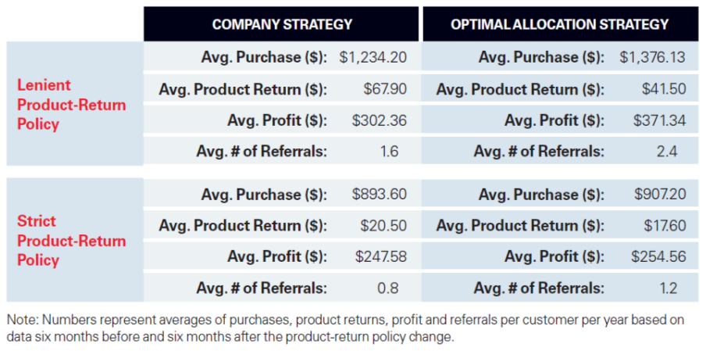
Product Returns: Study 2

Slide 35
Product Returns
Summary:
  Product returns are not a necessary evil
  A satisfactory product return experience can actually lead to improved customer relationships and increases in future purchase behavior (and profitability)
  The key is in understanding the drivers and consequences of customer product return behavior

Slide 36
For Next Class
Topic:
  Summary and Wrap-up
Reading:
  None
Assignment:
  Team Case: Netflix

